Slide 1
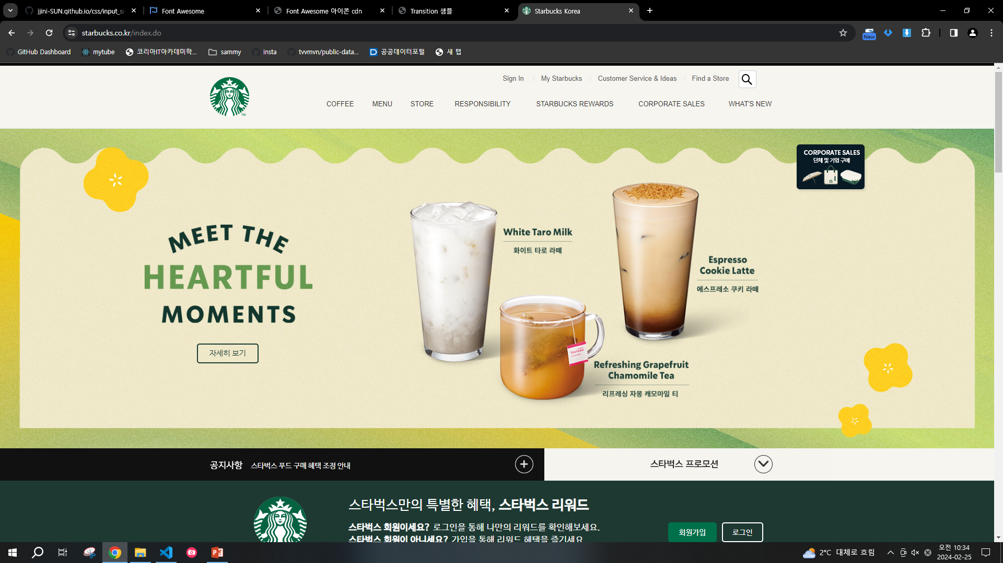
①
⑤
③
⑥
②
④
번호 | 명칭 | 정의
1 | Section-header | Width:100%, height:120px, background:rgb(246, 245, 239)
2 | Inner-header | Width:1100px;(반응형 추후 결정), height:100%; margin:auto; display:flex, justify-content:space-between; padding-left:100px;
3 | logo | width:75px; height:75px;
4 | Space-nav | display:inline-block; padding-right:15px; padding-left:15px; border-right: 1px solid lightgrey;
5 | Top-nav | Display:felx; jutify-content:flex-end; height:45px; font-size:13px; (안쪽 ul >li > a) (안쪽 마지막 ul >li > button > icon)
6 | Bottom-nav | display:flex; justify-content: flex-end; (안쪽 ul >li > a)

Slide 2
①
⑤
⑥
②
③
④
⑦
번호 | 명칭 | 설계결정
1 | Main-slogan | Width:100%, Height:30vh(안되면 368px); background-image Position:relative;
2 | Main-left-div | Width:185px, height:150px; position:absolute; left:180px; top:50%; transform:translate(-50%,-50%);
3 | Main-letter | Width:100%, height:100px; img(MEETtheMOMENT.png)
4 | Main-button | Width:100%, height:40px; background(239, 233, 201); outline:2px solid black;
5 | tarolatte | Width:190px, height:200px; img(tarolatte.png); position:absolute; left(추후), top(추후)
6 | cookielatte | Width:190px, height:200px; img(cookielatte.png); position:absolute; left(추후), top(추후)
7 | chamomiletea | Width:200px, height:150px; img(chamomiletea.png); position:absolute; left(추후), top(추후)

Slide 3
②
③
①
번호 | 명칭 | 설계결정
1 | Main-slogan-under | Width:100%, Height:62px; display:flex;
2 | notice | Width:55%, height:100%; background:black;
3 | promotion | Width:45%, height:100%; background:(246, 245, 239);

Slide 4

①
②
c
⑤
④
③
⑥
번호 | 명칭 | 설계결정
1 | Section-rewards | Width:100%, Height:15vh(안되면 240px); background(30, 57, 50); Display:flex; align-items:center; justify-content:center;
2 | Inner-rewards | Width:1000px, height:170px;
3 | Logo-rewards | Width:176px, height:153px; float:left; <img(starbucks_logo_rewards.png)>
4 | Content-rewards | Width:824px, height: 100%; float:left;
5 | Top-rewards | Width:794px, height:95px; border-bottom:1px solid grey;
6 | Bottom-rewards | Width:794px, height:40px;

Slide 5

③
②
①
번호 | 명칭 | 설계결정
1 | Slogan_spring | Width:100%, Height:30vh(안되면 495px); background-image; position:relative;
2 | Spring_img | Width:325px, height:410px; position:absolute; left:30%; top:10%; Img(spring_img.png);
3 | Spring_letter | Width:299px, height:196px; position:absolute; left:55%; top:50%; transform:translate(0, -50%); <img(spring_letter) / button>
Float:left 없이 relative, absolute로 가로 정렬 가능한지 테스트해보기

Slide 6

①
②
③
번호 | 명칭 | 설계결정
1 | Slogan_salvador | Width:100%, Height:20vh(안되면 400px); background-image; position:relative;
2 | salvador_letter | Width:382px, height:129px; position:absolute; left:25%; top:10%; Img(Salvador_letter.png); ((top부터 이미지 까지 길이
3 | salvador_button | Width:300px, height:40px; position:absolute; right:50%; top:55%; (추후 다시)

Slide 7
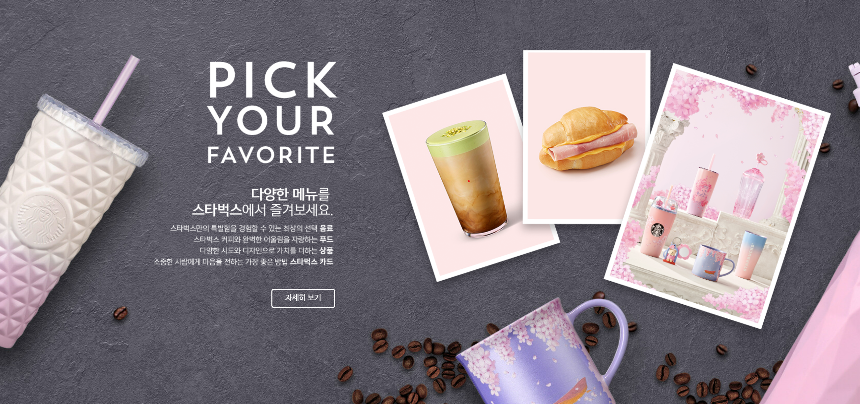
②
③
④
⑤
①
번호 | 명칭 | 설계결정
1 | Slogan-pick | Width:100%, Height:800px; background-image;
2 | Pick-letter | Width:1080px, height:170px;
3 | Pick-content | Width:176px, height:153px; img(starbucks_logo_rewards.png)
4 | Pick-button | Width:794px, height:95px; border-bottom:1px solid grey;
5 | Pick-img | Width:794px, height:40px;

Slide 8
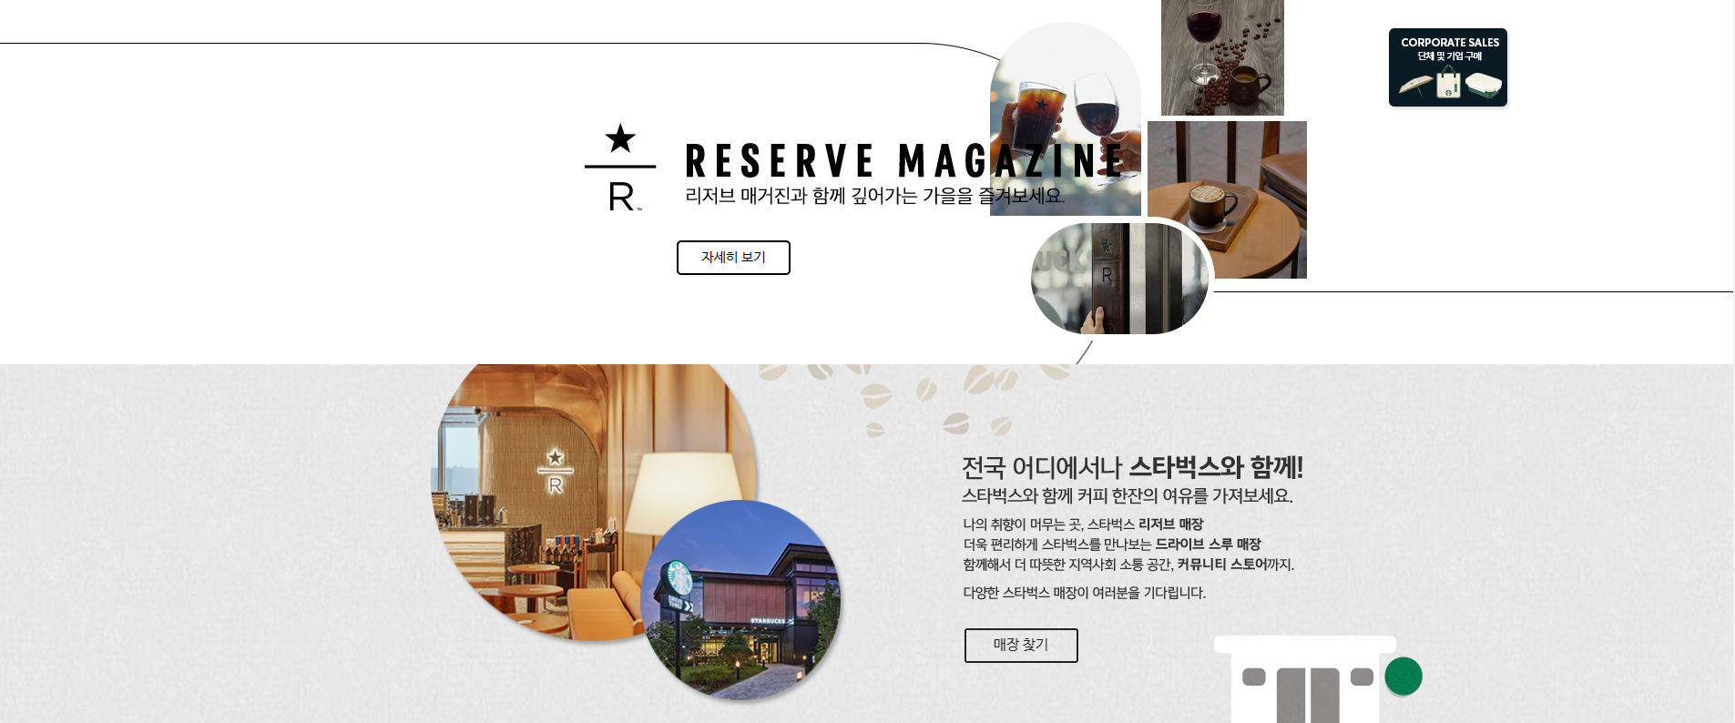

Slide 9
